Slide 1
Tree Data Structure (Binary Tree)
Week 8

Slide 2
Contents
Introduction to Trees
Trees properties
Type of trees
Trees operations
Construct a binary tree
Search
Delete
Pre-order
Post-order
Level-order

Slide 3
Introduction
Tree is a hierarchical data structure which stores the information naturally in the form of hierarchy.
Applications : searching, sorting, decision tree, indices for databases.
A tree contains nodes(data) and connections(edges) which should not form a cycle.
Node — A node is a structure which may contain a value or condition, or represent a separate data structure.
Root — The top node in a tree, the prime ancestor.
Child — A node directly connected to another node when moving away from the root, an immediate descendant.
Parent — The converse notion of a child, an immediate ancestor.

Slide 4
Tree Properties
Node — A node is a structure which may contain a value or condition, or represent a separate data structure.
Root — The top node in a tree, the prime ancestor.
Child — A node directly connected to another node when moving away from the root, an immediate descendant.
Parent — The converse notion of a child, an immediate ancestor.
Leaf — A node with no children.
Internal node — A node with at least one child.

Slide 5
Tree Properties
Edge — The connection between one node and another.
Depth — The distance between a node and the root.
Level — the number of edges between a node and the root + 1
Height — The number of edges on the longest path between a node and a descendant leaf.
Breadth — The number of leaves.
Binary Tree — is a tree data structure in which each node has at most two children, which are referred to as the left child and the right child.
Traversing − Traversing means passing through nodes in a specific order.

Slide 6
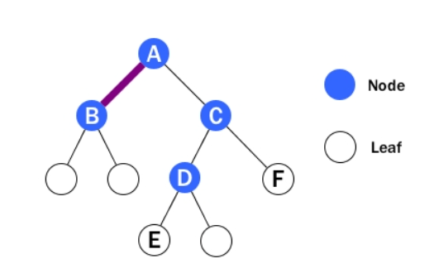
Node, Leaf, Edge

Slide 7
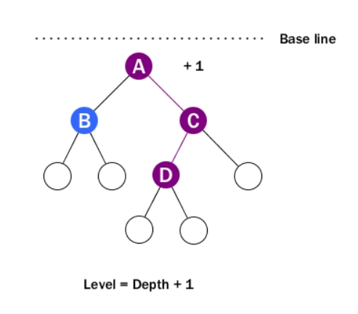
Tree Level
Level 1
Level 2
Level 3
Level 4

Slide 8
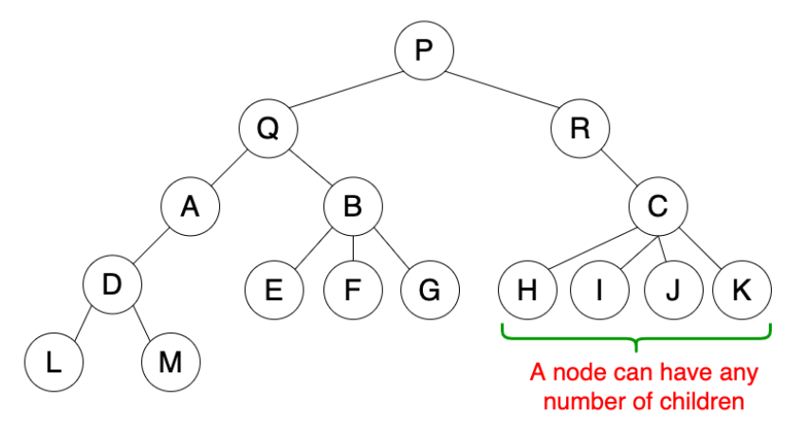
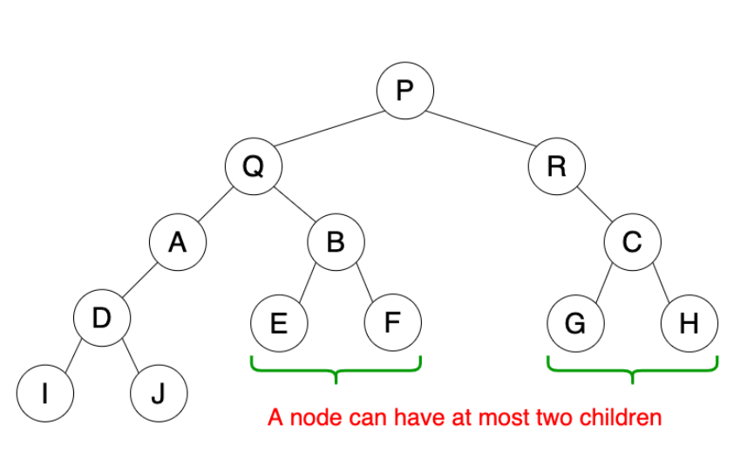
Type of Trees
General tree
General tree
Binary tree
Binary Heap tree
Binary search tree
Binary tree

Slide 9
Binary Tree – Create a Node
class Node {
int value;
Node left;
Node right;
Node(int value) {
this.value = value;
right = null;
left = null;
}
}
20
null
null

Slide 10
Construct a binary tree
Use recursion to construct a binary tree
The first node added will be the root of the entire tree
If the new node (value) is less than the root, the new node will be on the left
If the new node (value) is greater than the root, the new node will be on the right
These processes loop using recursion until the new node becomes a root of a branch.

Slide 11
Construct a binary tree
Elements to be constructed in a tree:
32, 12, 23, 36, 39, 33
32
32
null
null
12
null
null
null

Slide 12
Construct a binary tree
Elements to be constructed in a tree:
32, 12, 23, 36, 39, 33
32
32
12
null
12
null
null
null
null
23

Slide 13
Construct a binary tree
Elements to be constructed in a tree:
32, 12, 23, 36, 39, 33
32
32
12
null
12
36
null
23
null
23
null
null

Slide 14
Construct a binary tree
Elements to be constructed in a tree:
32, 12, 23, 36, 39, 33
32
32
12
36
12
36
null
23
null
null
null
23
null
39

Slide 15
Construct a binary tree
Elements to be constructed in a tree:
32, 12, 23, 36, 39, 33
32
32
12
36
12
36
null
23
null
39
null
23
33
39

Slide 16
Construct a binary tree
Add a Node
Input: | root = current root of the tree value = the new node value
1) | Let root = addRecursive (root, value)
Output: | Void function
addRecursive
Input: | root = current root of the tree value = the new node value
1) | If value of root == null set value as root
2) | End if
3) | If value < value of root
4) | root’s left = addRecursive (root’s left, value)
5) | Else If value > value of root
6) | root’s right = addRecursive (root’s right, value)
7) | Else return root
8) | End if
9) | return root
Output: | A binary tree

Slide 17
Search a node
1. We also use recursion to search a node in a binary tree
2. Start from the root, if the root is not null (if null return false), check whether the root is the value, return true if it is.
3. If the root is not the value, go to the left if the value is less than the root, otherwise go to the right. Execute point no 2 again (recursion).

Slide 18
Search a node
containsNode
Input: | root = the binary tree root value = the new node value
1) | Let root = containsNodeRecursive (root, value)
Output: | Void function
containsNodeRecursive
Input: | root = current root of the tree value = the new node value
1) | If (root == null) return false
2) | End if
3) | If value == value of root return true
4) | End if
5) | return containsNodeRecursive(root’s left, value) if value < root’s value otherwise return containsNodeRecursive(root’s right, value)
Output: | True or False

Slide 19
Delete a node
If the root is null, return null. No tree available.
If the value == to the root:
Return null if both left and right are null.
Return left if the right node is null. Making the left node as the root.
Return right if the left node is null. Making the right node as the root.
If both left and right nodes are not null,
Go to the right node, and find the smallest node
Set the current node as the smallest node found
Then delete the smallest value from the tree

Slide 20
Delete a node - continued
If the value < root
Call the function again (recursive) by passing the left node as the root.
Otherwise (value > root) call the function again (recursive) by passing the right node as the root.

Slide 21

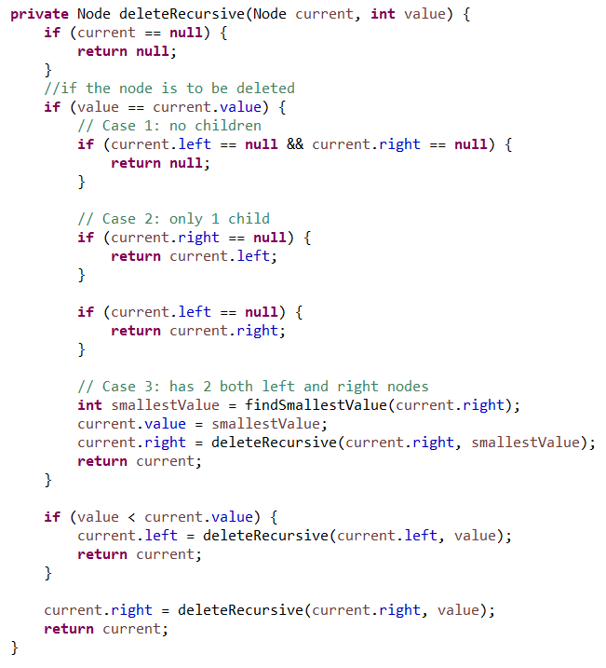

Delete : Let See the Code

Slide 22
Traversal – Pre-order
Depth First Search: Root=>Left=>Right
32
Nodes order : 32, 12, 23, 36, 33, 39
12
36
null
23
33
39

Slide 23
Traversal – Pre-order
Binary Tree Traverse PreOrder
Input: | root = the root of the binary tree
1) | If root is not null
2) | Print the root’s value
3) | Recursive Binary Tree Traverse PreOrder (root’s left)
4) | Recursive Binary Tree Traverse PreOrder (root’s right)
5) | Endif
Output: | List of nodes traversed in pre-order

Slide 24
Traversal – Post-order
Left=>Right=>Node
32
Nodes order : 32, 12, 23, 36, 33, 39
12
36
null
23
33
39

Slide 25
Traversal – Post-order
Binary Tree Traverse PostOrder
Input: | root = the root of the binary tree
1) | If root is not null
2) | Recursive Binary Tree Traverse PreOrder (root’s left)
3) | Recursive Binary Tree Traverse PreOrder (root’s right)
4) | Print the root’s value
5) | Endif
Output: | List of nodes traversed in post-order

Slide 26
Traversal – Level-order
Breadth-First Search: visit all the nodes present at the same level one-by-one from left to right and then move to the next level to visit all the nodes of that level.
32
12
36
Nodes order : 32, 12, 36, 23, 33, 39
null
23
33
39

Slide 27
Traversal – Level-order
Binary Tree Traverse Level Order
Input: | root = the root of the binary tree
1) | If root is not null
2) | Let queue = a linkedlist object
3) | Add the root of the tree to queue
4) | While queue is not empty
5) | Let node = remove a node from queue
6) | Print the value of node
7) | If left’s node != null
8) | Add left’s node to queue
9) | Endif
10) | If right’s node != null
11) | Add right’s node to queue
12) | Endif
13) | Endif
Output: | List of nodes traversed in level-order

